Slide 1
Data types:
There are 3 data types in SQL:
String
Numeric
Date and Time
String:
Data type | Description
CHAR(size) | A FIXED length string (can contain letters, numbers, and special characters). The size parameter specifies the column length in characters - can be from 0 to 255. Default is 1
VARCHAR(size) | A VARIABLE length string (can contain letters, numbers, and special characters). The size parameter specifies the maximum column length in characters - can be from 0 to 65535
BINARY(size) | Equal to CHAR() But stores binary byte strings. The size parameter specifies the column length in bytes. Default is 1
VARBINARY(size) | Equal to VARCHAR() But stores binary byte strings. The size parameter specifies the maximum column length in bytes.
TINYBLOB | For BLOBs (Binary Large OBjects). Max length: 255 bytes
TINYTEXT | Holds a string with a maximum length of 255 characters
TEXT(size) | Holds a string with a maximum length of 65,535 bytes
BLOB(size) | For BLOBs (Binary Large OBjects). Holds up to 65,535 bytes of data
MEDIUMTEXT | Holds a string with a maximum length of 16,777,215 characters

Slide 2
Data type | Description
MEDIUMBLOB | For BLOBs (Binary Large Objects). Holds up to 16,777,215 bytes of data
LONGTEXT | Holds a string with a maximum length of 4,294,967,295 characters
LONGBLOB | For BLOBs (Binary Large Objects). Holds up to 4,294,967,295 bytes of data
ENUM(val1, val2, val3, ...) | A string object that can have only one value, chosen from a list of possible values. You can list up to 65535 values in an ENUM list. If a value is inserted that is not in the list, a blank value will be inserted. The values are sorted in the order you enter them
SET(val1, val2, val3, ...) | A string object that can have 0 or more values, chosen from a list of possible values. You can list up to 64 values in a SET list

Slide 3
Numeric:
Data type | Description
BIT(size) | A bit-value type. The number of bits per value is specified in size. The size parameter can hold a value from 1 to 64. The default value for size is 1.
TINYINT(size) | A very small integer. Signed range is from -128 to 127. Unsigned range is from 0 to 255. The size parameter specifies the maximum display width (which is 255)
BOOL | Zero is considered as false, nonzero values are considered as true.
BOOLEAN | Equal to BOOL
SMALLINT(size) | A small integer. Signed range is from -32768 to 32767. Unsigned range is from 0 to 65535. The size parameter specifies the maximum display width (which is 255)
MEDIUMINT(size) | A medium integer. Signed range is from -8388608 to 8388607. Unsigned range is from 0 to 16777215. The size parameter specifies the maximum display width (which is 255)
INT(size) | A medium integer. Signed range is from -2147483648 to 2147483647. Unsigned range is from 0 to 4294967295. The size parameter specifies the maximum display width (which is 255)
INTEGER(size) | Equal to INT(size)
BIGINT(size) | A large integer. Signed range is from -9223372036854775808 to 9223372036854775807. Unsigned range is from 0 to 18446744073709551615. The size parameter specifies the maximum display width (which is 255)
FLOAT(size, d) | A floating point number. The total number of digits is specified in size. The number of digits after the decimal point is specified in the d parameter. This syntax is deprecated in MySQL 8.0.17, and it will be removed in future MySQL versions

Slide 4
Data type | Description
FLOAT(p) | A floating point number. MySQL uses the p value to determine whether to use FLOAT or DOUBLE for the resulting data type. If p is from 0 to 24, the data type becomes FLOAT(). If p is from 25 to 53, the data type becomes DOUBLE()
DOUBLE(size, d) | A normal-size floating point number. The total number of digits is specified in size. The number of digits after the decimal point is specified in the d parameter
DOUBLE PRECISION(size, d)
DECIMAL(size, d) | An exact fixed-point number. The total number of digits is specified in size. The number of digits after the decimal point is specified in the d parameter. The maximum number for size is 65. The maximum number for d is 30. The default value for size is 10. The default value for d is 0.
DEC(size, d) | Equal to DECIMAL(size, d)

Slide 5
Date and Time:
Data type | Description
DATE | A date. Format: YYYY-MM-DD. The supported range is from '1000-01-01' to '9999-12-31'
DATETIME(fsp) | A date and time combination. Format: YYYY-MM-DD hh:mm:ss. The supported range is from '1000-01-01 00:00:00' to '9999-12-31 23:59:59’. Adding DEFAULT and ON UPDATE in the column definition to get automatic initialization and updating to the current date and time
TIMESTAMP(fsp) | A timestamp. TIMESTAMP values are stored as the number of seconds since the Unix epoch ('1970-01-01 00:00:00' UTC). Format: YYYY-MM-DD hh:mm:ss. The supported range is from '1970-01-01 00:00:01' UTC to '2038-01-09 03:14:07' UTC. Automatic initialization and updating to the current date and time can be specified using DEFAULT CURRENT_TIMESTAMP and ON UPDATE CURRENT_TIMESTAMP in the column definition
TIME(fsp) | A time. Format: hh:mm:ss. The supported range is from '-838:59:59' to '838:59:59'
YEAR | A year in four-digit format. Values allowed in four-digit format: 1901 to 2155, and 0000. MySQL 8.0 does not support year in two-digit format.

Slide 6
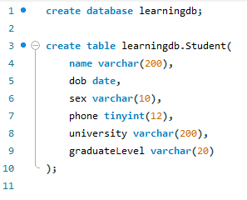
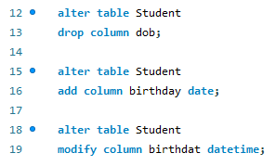
DDL (Data Definitely language):
DDL là ngôn ngữ định nghĩa dữ liệu gồm các câu lệnh:
CREATE (Tạo mới Database/table)
ALTER (Sửa, thêm cột, chỉnh sửa cột, xóa cột, đổi tên cột hoặc đổi tên bảng)
DROP (Xóa bảng khỏi database, dung trong alter để xóa cột ra khỏi bảng)
RENAME
Create:
Alter:

Slide 7
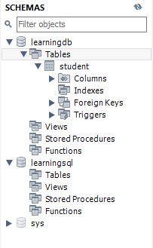
Schema:
Là một namespace dùng để gom nhóm các table có chung một đặc điểm nào đó đễ dễ dàng quản lý.
Nếu không sử dụng schema trong CSDL thì nó sẽ lấy schema mặc định là dbo.
Table:
Một bảng (table) thuộc 1 database.
Bao gồm:
tên table
danh sách cột (column)
khóa chính (primary key)
khóa ngoại (Foreign key)

Slide 8
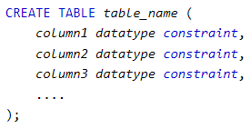
Constraints:
Constraints can be specified when the table is created with the CREATE TABLE statement, or after the table is created with the ALTER TABLE statement.
Keys | Describe
NOT NULL | Ensure that a column cannot have a NULL value
UNIQUE | Ensure that all values in column are different, have no duplicates.
PRIMARY KEY | A combination of a NOT NULL and UNIQUE. Uniquely identifies each row in a table
FOREIGN KEY | Refer to other tables through value of referenced column. Referenced column must be unique in referenced table.
CHECK | Ensures that the values in a column satisfies a specific condition
DEFAULT | Sets a default value for a column if no value is specified
INDEX | Used to create and retrieve data from the database very quickly

Slide 9
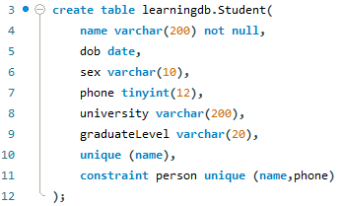
Not null & Unique:
NOT NULL:
By default, a column can hold NULL values.
The NOT NULL constraint enforces a column to NOT accept NULL values.
Unique:
The UNIQUE constraint ensures that all values in a column are different, don’t have duplicates.
Can have many UNIQUE constraints per table
Can define a UNIQUE contraint on multiple columns.

Slide 10
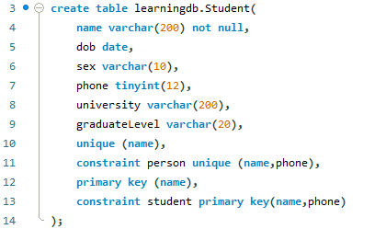
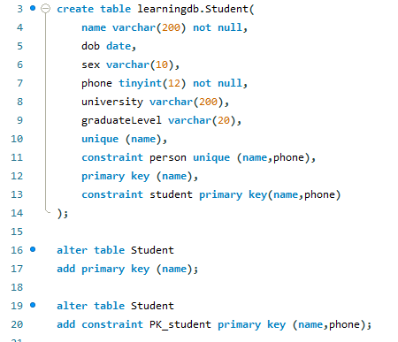

Primary Key:
The PRIMARY KEY constraint uniquely identifies each record in a table.
Primary keys must contain UNIQUE values and cannot contain NULL values.
A table can have only ONE primary key, this primary key can consist of single or multiple columns (fields).
PRIMARY KEY on ALTER TABLE:
Create a PRIMARY KEY constraint on the "ID" column when the table is already created.
Note: If you use ALTER TABLE to add a primary key, the primary key column(s) must have been declared to not contain NULL values (when the table was first created).
To drop a PRIMARY KEY constraint, use the following SQL:

Slide 11
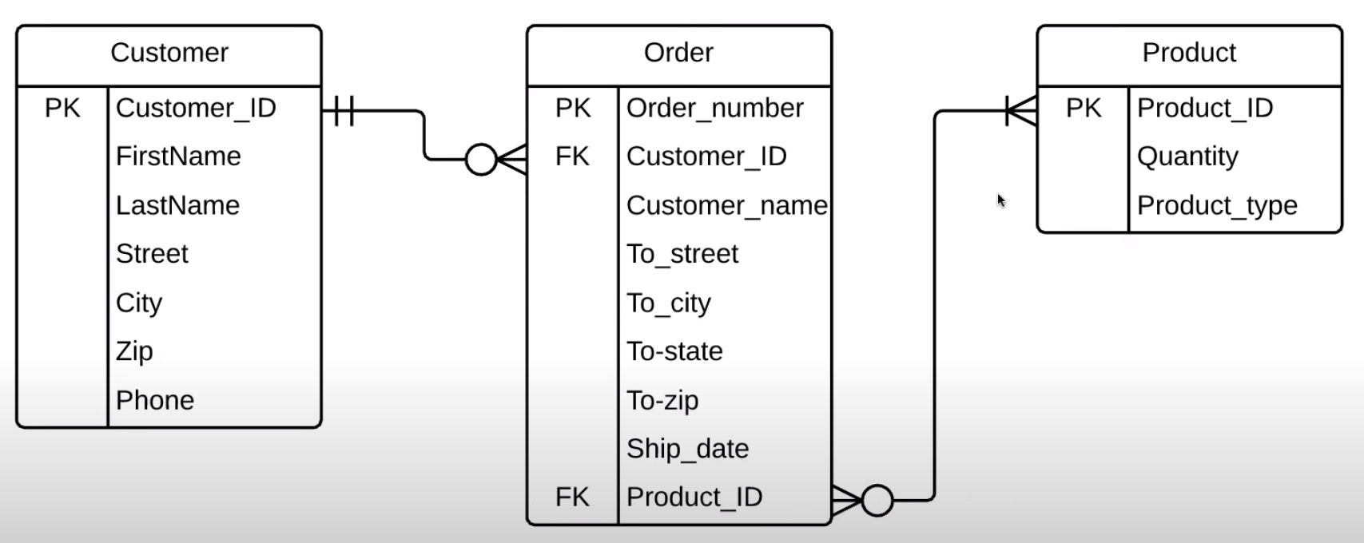
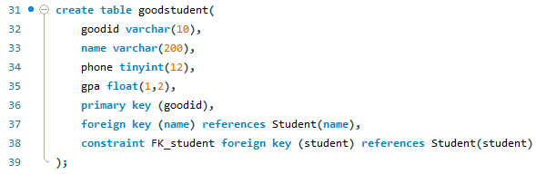
FOREIGN Key:
The FOREIGN KEY constraint is used to prevent actions that would destroy links between tables.
A FOREIGN KEY is a field (or collection of fields) in one table, that refers to the PRIMARY KEY in another table.
The table with the foreign key is called the child table, and the table with the primary key is called the referenced or parent table.

Slide 12
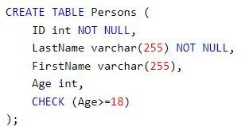
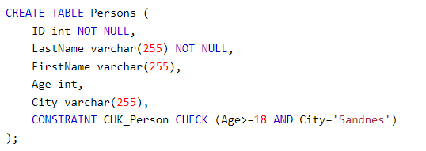
Check Key:
The CHECK constraint is used to limit the value range that can be placed in a column.
If you define a CHECK constraint on a column it will allow only certain values for this column.
If you define a CHECK constraint on a table, it can limit the values in certain columns based on values in other columns in the row.
The following SQL creates a CHECK constraint on the "Age" column when the "Persons" table is created. The CHECK constraint ensures that the age of a person must be 18, or older:
Naming of a CHECK constraint, and defining a CHECK constraint on multiple columns

Slide 13
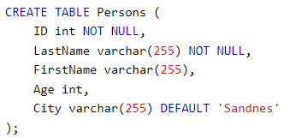
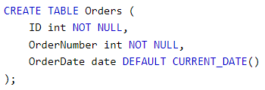
Default Key:
The DEFAULT constraint is used to set a default value for a column.
The default value will be added to all new records, if no other value is specified.
The DEFAULT constraint can also be used to insert system values, by using functions like CURRENT_DATE()

Slide 14
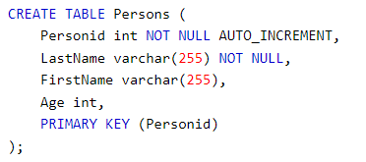

Auto increment:
Auto-increment allows a unique number to be generated automatically when a new record is inserted into a table.
Often this is the primary key field that we would like to be created automatically every time a new record is inserted.
MySQL uses the AUTO_INCREMENT keyword to perform an auto-increment feature.
By default, the starting value for AUTO_INCREMENT is 1, and it will increment by 1 for each new record.
let the AUTO_INCREMENT sequence start with another value

Slide 15


Create index:
The CREATE INDEX statement is used to create indexes in tables.
Indexes are used to retrieve data from the database more quickly than otherwise. The users cannot see the indexes, they are just used to speed up searches/queries.
Note: Updating a table with indexes takes more time than updating a table without (because the indexes also need an update). So, only create indexes on columns that will be frequently searched against.

Slide 16
Clustered & non-Clustered index:
parameter | Clustered Index | Non-Clustered Index
Definition | A clustered index is a table where the data for the rows are stored. In a relational database, if the table column contains a primary key, MySQL automatically creates a clustered index named PRIMARY. | The indexes other than PRIMARY indexes (clustered indexes) called a non-clustered index. The non-clustered indexes are also known as secondary indexes.
Use for | It can be used to sort the record and store the index in physical memory. | It creates a logical ordering of data rows and uses pointers for accessing the physical data files.
Size | Its size is large. | Its size is small in comparison to a clustered index.
Data Accessing | It accesses the data very fast. | It has slower accessed power in comparison to the clustered index.
Storing Method | It stores records in the leaf node of an index. | It does not store records in the leaf node of an index that means it takes extra space for data.
Additional Disk Space | It does not require additional reports. | It requires an additional space to store the index separately.
Type of Key | It uses the primary key as a clustered index. | It can work with unique constraints that act as a composite key.
Contains in Table | A table can only one clustered index. | A table can contain one or more than a non-clustered index.
Index Id | A clustered index always contains an index id of 0. | A non-clustered index always contains an index id>0.

